Slide 1

Construction company Management system
Jaleena maria thomas
22pmc128

Slide 2

Abstract
project aimed at developing a construction company management system that incorporates rental equipment functionalities. The purpose of the website is to provide a user-friendly platform for construction companies to efficiently manage their operations and rental equipment inventory. The system will enable companies to streamline project management processes, including project planning, scheduling, and resource allocation. Additionally, it will include features for tracking and managing rental equipment, such as equipment availability, maintenance schedules, and rental bookings. The website will have an intuitive interface, allowing users to easily input and retrieve data, generate reports, and monitor project and equipment statuses. By implementing this website project, construction companies will be able to enhance their overall efficiency, reduce manual errors, and provide reliable rental equipment services to their customers.

Slide 3
Project requirements
1.User registration and login
2. Profile management
3.Users can search the building plan
4.Status update for building plan
5.Add building requirements
6.Ability to view user requirement
7.Equipment rental management
8.Add plans
9. Home Delivery of Rental Equipment

Slide 4

Features and Highlights
Registration forms
users and architects can register and
perform their functions.
Add requirements
users can add their requirment
Add plans
architects can add their plans and works
Rental equipment
users to browse and rent equipment and machinery directly within the system
Home delivery of rented equipment
Users can easily get equipment in their doorsteps.
Approve users
Django- admin approve users and architects
Search
users can can search for building plans.

Slide 5


Technical Aspects
Programming languages and framework
Python and django framework
Front end development: HTML ,CSS,
JAVASCRIPT, and BOOTSTRAP
Database management
Sqlite3

Slide 6

Libraries
Jazzmin
Django-Jazzmin is a customizable theme for the Django admin interface, which is the default administration interface that comes with Django.
Pillow
It provides functions for basic image processing tasks like resizing, cropping, rotating, and applying various filters to images.
Bootstrap
Bootstrap is a popular front-end framework for building responsive and mobile-first websites and web applications.

Slide 7
Architecture
Architecture follows a client -server model, where the client (web browser) sends requests to the server (Django application), which processes the requests, interacts with the database, and generates responses to be sent back to the client.
*Models
*Views
*Templates
*URL Configuration
*Static Files etc.

Slide 8
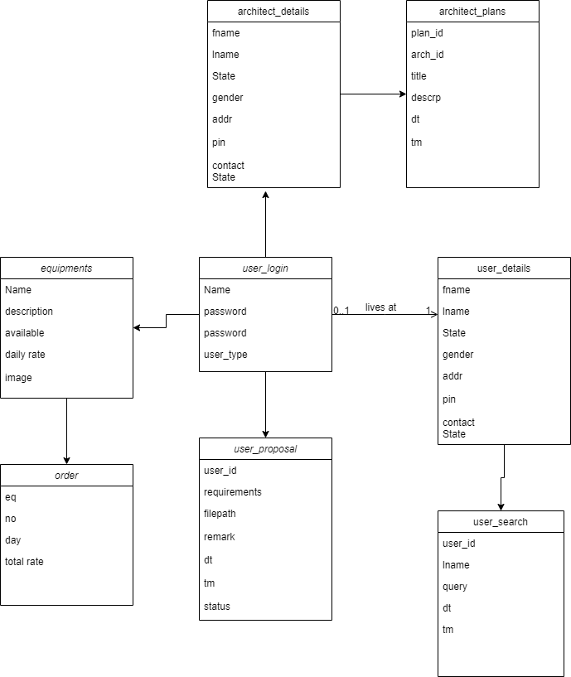
CLASS DIAGRAM

Slide 9
Challenges
User interface design and usability: When using Bootstrap and templates in a project, several challenges can arise. Firstly, customization can be a challenge, as Bootstrap offers a predefined set of styles and components that may not perfectly align with the desired design or branding of the project. Adapting and customizing the Bootstrap framework and templates to match specific requirements can require additional effort and CSS overrides.
Testing and quality assurance: Ensuring the system functions correctly, identifying and resolving bugs or issues, and ensuring the system meets the desired quality standards may pose difficulties during the project.
Working with virtual environments: it can be challenging, especially for newcomers. The setup and configuration process, managing dependencies, maintaining consistency across environments, collaborating with others, integrating with system-level tools, upgrading environments, and the learning curve are common challenges faced. However, with practice and experience, developers can overcome these challenges and leverage the benefits of virtual environments for better project management and dependency isolation.

Slide 10
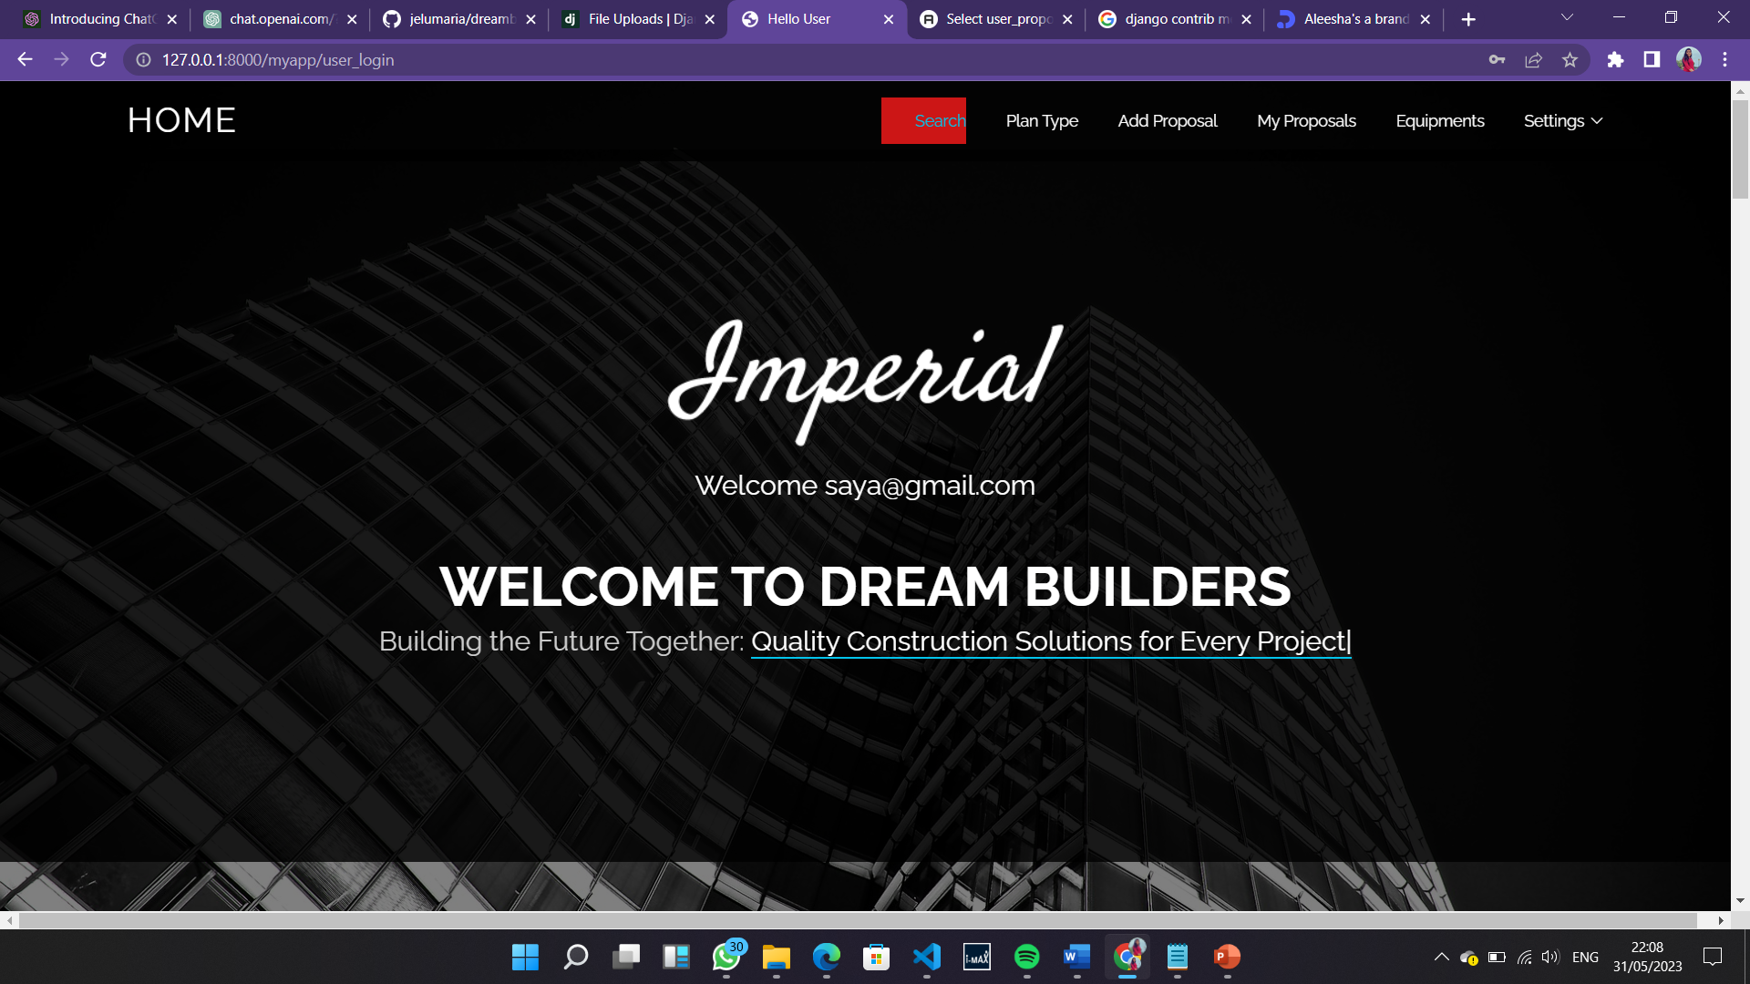
SCREENSHOTS

Slide 11
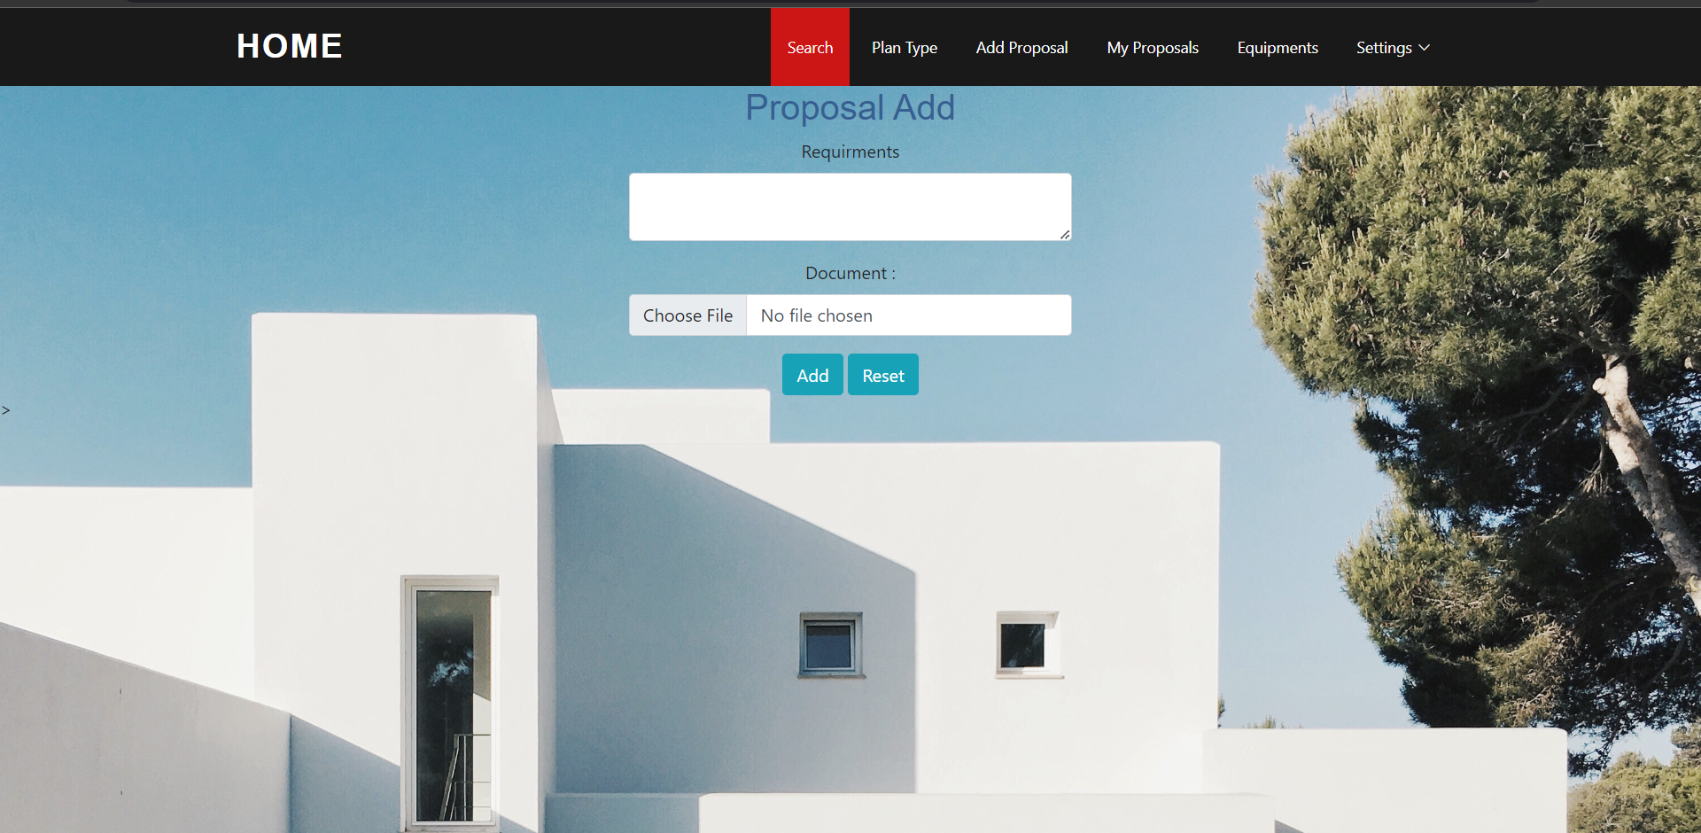
SCREENSHOTS

Slide 12
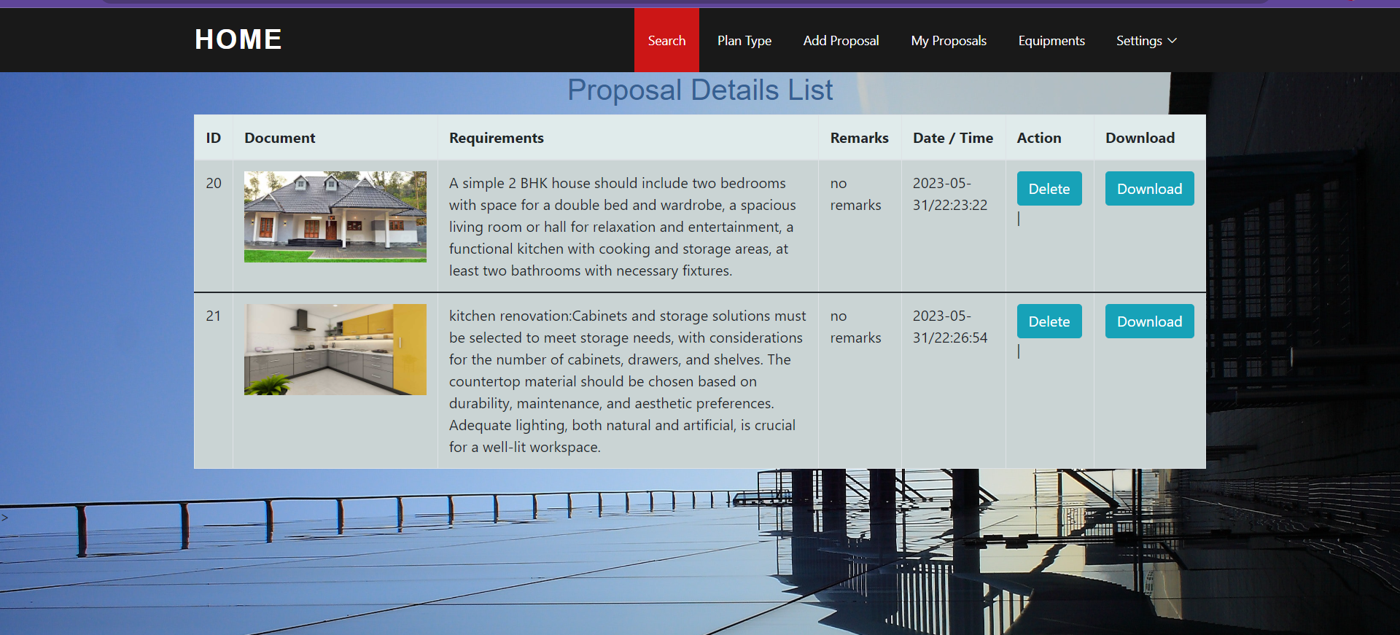
SCREENSHOTS

Slide 13
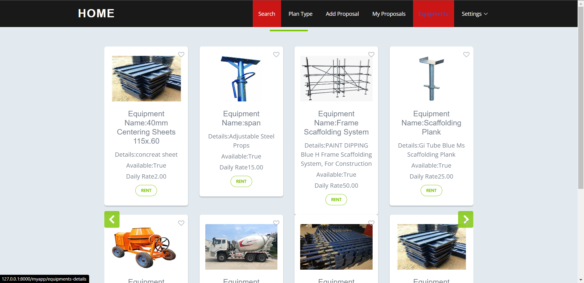
SCREENSHOTS

Slide 14
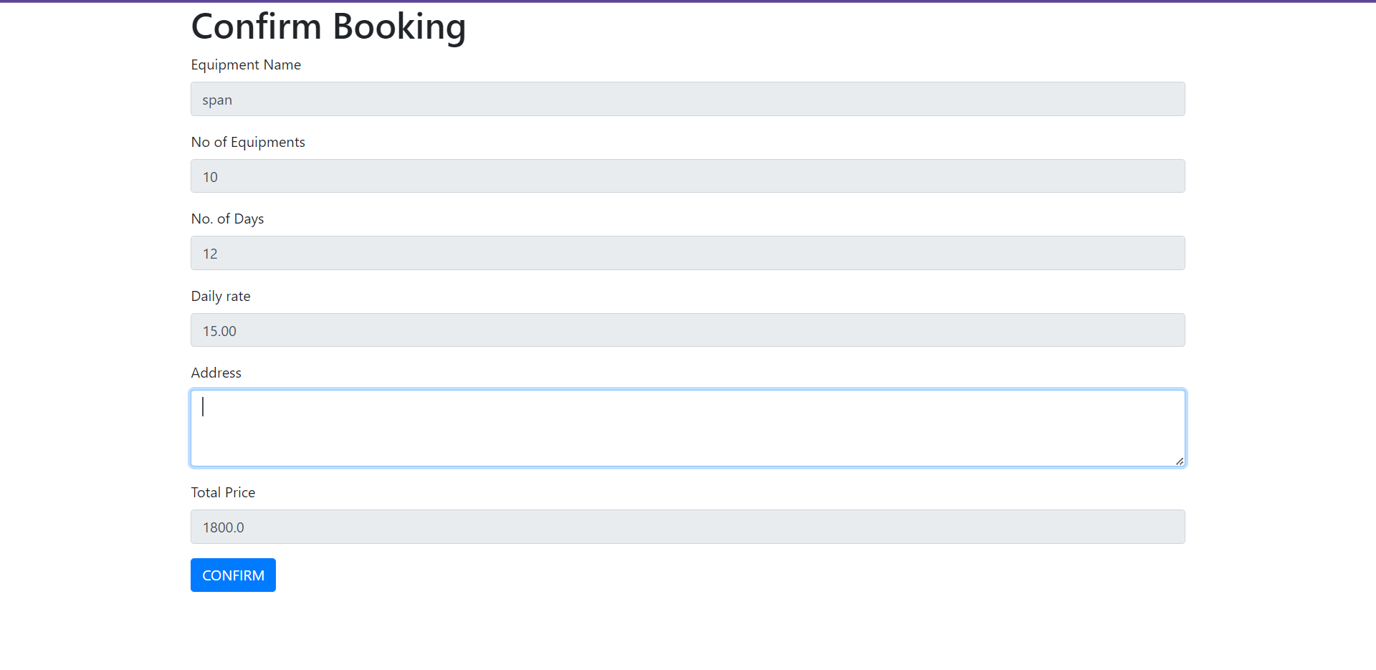
SCREENSHOTS

Slide 15
3.Add labor management
2.Advanced searching and filtering
1.Notification
FUTURE ENHANCEMENT

Slide 16
https://medium.com/@ajitdhulam/django-framework-df3ab4ddd09c
https://chat.openai.com/c/b9c4c6ef-09d6-45ad-8e70-b85de1ff2d46
https://getbootstrap.com/docs/5.2/getting-started/introduction/
https://stackoverflow.com/questions/20473572/django-rest-framework-file-upload
References

Slide 17
CONCLUSION
In conclusion, The system offers features such as user registration and login, profile management, viewing user requirements, and status updates for building plans.
The presentation highlighted the user-friendly interface and intuitive design of the system, enabling easy navigation and seamless project management.
Overall, the Construction Company Management System presented a comprehensive solution to address the challenges of construction project management, promoting efficiency and successful project completion.
Automating the functions of our company.

Slide 18
THANK YOU

